Slide 1
Business Plan
Sprout
June 2020

Slide 2


Slide 3
MEET SPROUT

Slide 4

What is Sprout?
Focus on social change
Vision:
Transform how we grow, share, and consume our food.
Mission:
Create a mutually beneficial relationship between local farmers, customers, and the environment through fair exchange and shared farm experience.

Slide 5
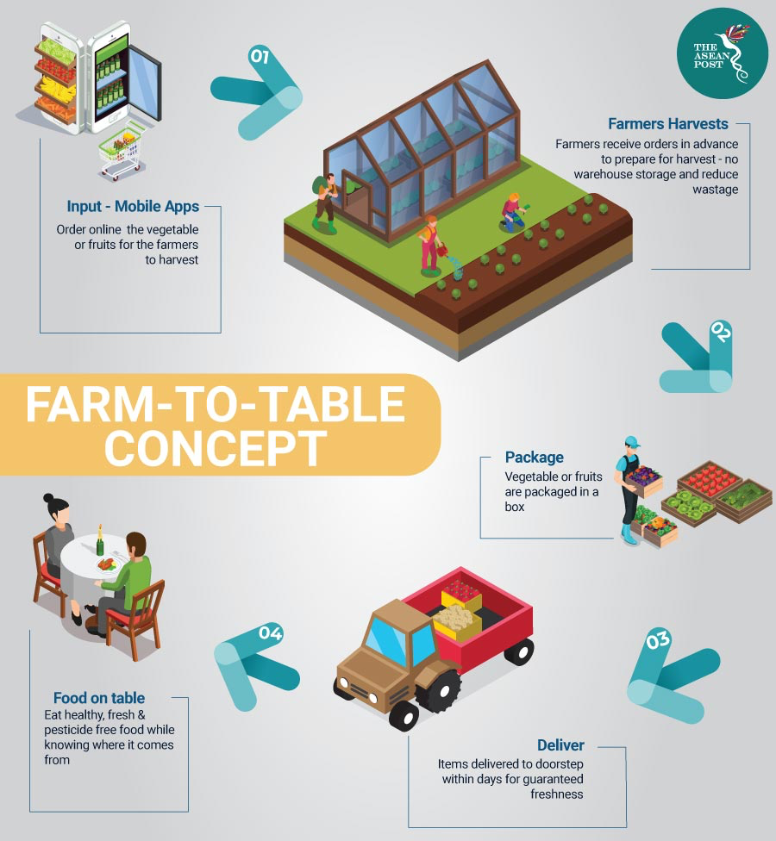


Slide 6
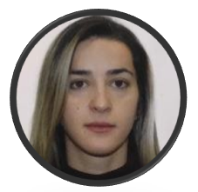




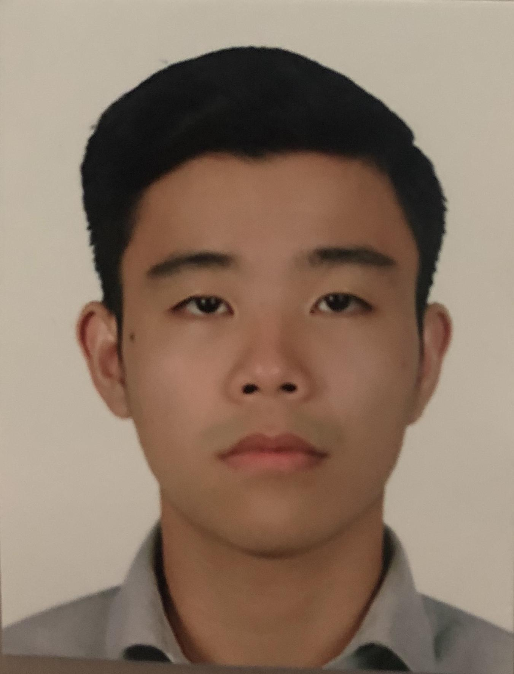
Meet the Team
Ariston Lim
Indonesia
Business Analyst
BDMA Masters Student
Julio Candela
Peru
Data Scientist
BDMA Masters Student
Nejada Karriqi
Albania
Software Engineer
Data Science Master Student
Valdemar Hernández Siles
Mexico
Digital Systems Engineer
BDMA Masters Student
Hung Nguyen
Vietnam
Data Scientist
BDMA Masters Student

Slide 7
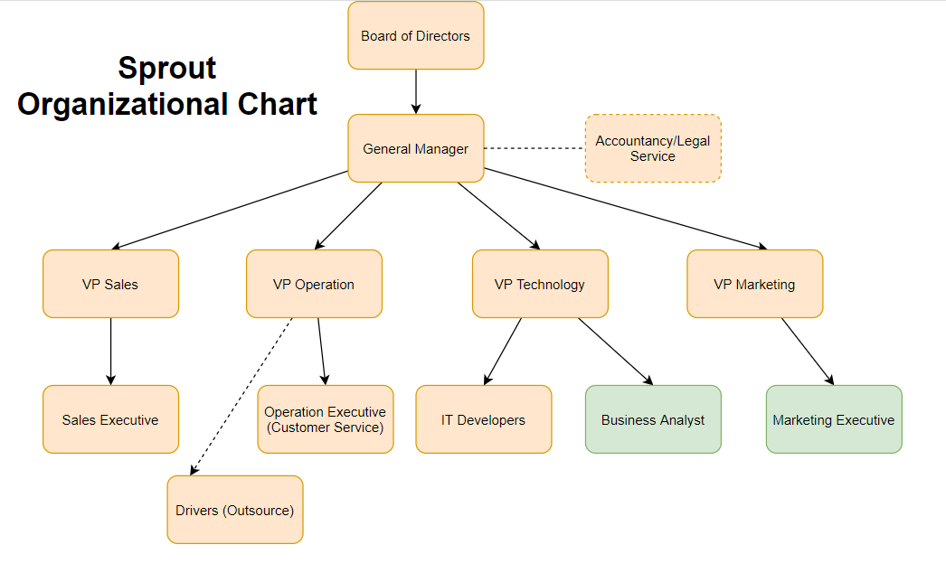
Organizational Chart

Slide 8
SECTOR ANALYSIS

Slide 9
SWOT Analysis
Strengths | Weaknesses
Attractive for farmers Provide an experience Eco-friendly Subscription model | Lack of capital More expensive Logistics
Opportunities | Threats
Few direct competitors Healthy trend Environmental awareness | EU Competition/Regulation Perishable food
Notes:
The organic spanish market registered an increase of 12.5% in 2017
The eco-friendly model can be used to promote the ecological message of the brand since many people are more aware of environmental issues and healthy lifestyles
Providing an experience will enhance users to become intimate partners with the company
The lack of capital can be reduced by gathering investors
Enough capital to compete in EU and be careful of perishable food.

Slide 10
Porter Analysis
Complex supplier management and logistics for new entrances
High Threat
Moderate Threat
Threat of Entrance
Low Threat
Lots of farms in Spain: many suppliers
Cheap prices for massive purchases of supermarkets
Power of Suppliers
Power of Clients
Competitive Rivalry
Few direct competitors
Threat of Substitutes
Lots of customers looking for cheap, fast and quality products
Supermarkets:
Cheap prices and close to homes.
Medium quality
Notes:
Spanish market is promising so that sprout can grow as a niche. The offer of suppliers is good since there are lots of them. Substitutes and customers has a lot of power, but we have to highlight experience over cheap products from supermarkets to make a difference. There are few competitors in our segment. As a consequence this is the right moment to enter to the market and get many people engaged into the Sprout experience.

Slide 11

Competitive Advantage
An integrated platform
Subscription System
Open-day - Farming Experience
Synergy among farmers, customers, the environment and Sprout
Smart Analytics
Notes:
An integrated platform: connect farmers and customers (know what you eat, know your farmer)
Subscription System: Generate frequent and loyal customers (offer discounts and experience)
Open-day - Farming Experience: No farmers ecommerce have implemented this idea.
Synergy among farmers, customers, the environment and Sprout
Smart Analytics: Recommendations for pricing, customers, and farmers.

Slide 12
MARKET
RESEARCH

Slide 13
Qualitative Market Research
CUSTOMERS
SUPPLIERS
COMPETITORS
20% of Spain’s total gross domestic product (GDP) comes from Catalonia.
Previous research on organic foods market show favorable attitudes toward organic foods in age groups of 18-25 and 26-35 years.
Amount of operators in Catalonia
Activity Type | Rank
Primary | 4th
Secondary | 1st
Tertiary | 1st
Services provided:
Seasonal products
Food baskets
Different sizes
Limited changes
Home delivery
Weekly
Charges for delivery
Contact with suppliers:
Home Delivery
Availability in supermarkets
Notes:
Customer age group: https://www.researchgate.net/publication/265969293_Consumer_segments_in_organic_foods_market
Catalonia GDP: https://www.cnbc.com/2017/09/21/heres-how-bad-economically-a-spain-catalonia-split-could-really-be.html
Spain’s Ministry of Agriculture: https://www.mapa.gob.es/es/alimentacion/temas/produccion-ecologica/estadisticaspe2018_tcm30-513741.pdf
Primary -> Extraction of raw materials. Secondary -> Manufacturing. Tertiary -> Services
cities for expansion

Slide 14



Competitors
Selling baskets of produce directly from farmers to customers.
Our unique selling point:
Subscription system
Farm visit

Slide 15
Quantitative Market Research
Key Findings:
Shopping Habit:
85% get their groceries from supermarkets, but 70% would consider buying online.
59% buys groceries once a week
Respondents use more recyclable materials (4.2/5)
Organic Food:
Respondents are less likely to go out of their way to get organic food, but they will consume more if they are more available (3.9/5)
Interest in Farm Visit:
Female 21-25 age group (7.2/10)
Female 26-30 age group (7.6/10)
Notes:
75 respondents, 87% age group 21 - 30, balanced split of gender
a lot of people said they will use more recyclable materials

Slide 16
MARKETING PLAN

Slide 17
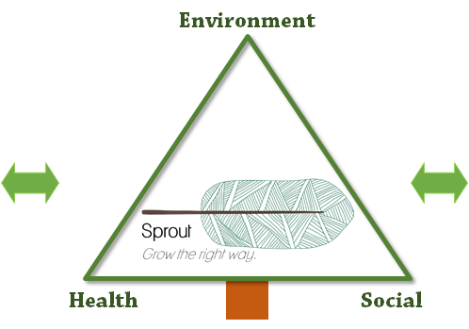


Strategic Marketing: Sprout Experience
Farms in Barcelona
Many farms within 150km
Good distribution channels
Variety of products
Customers
Age 18-25: Care for health , environment and experience
Age 25-35: Bigger tickets
Prone to use online channel.
😀 Social, environmental and healthy brand → Sprout
😀 Start as a niche and grow the right way with customers and farmers
Notes:
150km: It’s possible for users to visit.
Turn into a start competitor

Slide 18
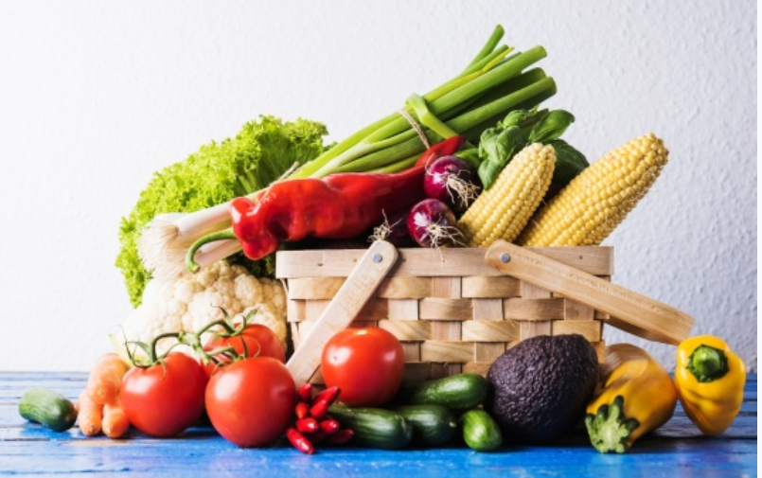
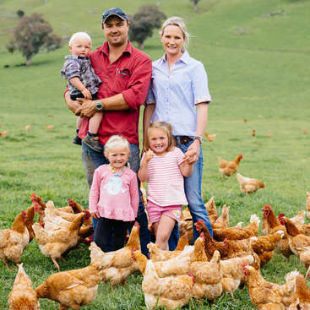
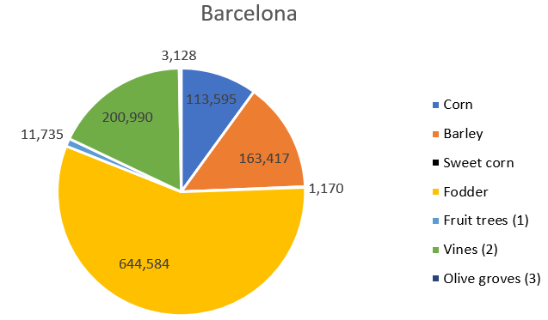
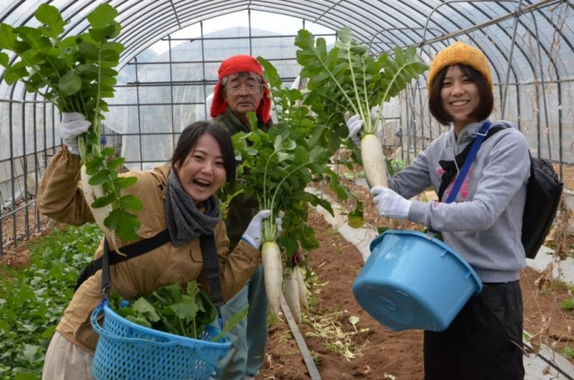
Products
Baskets of fresh products
Farming experience
Notes:
https://www.idescat.cat/pub/?id=aec&n=444&lang=en
In Sprout, we offer 2 main products,
overview of what kinds of crop growing in Spain. This is not a complete list
also depends on the farms and the seasons
Customized baskets:
The product selection is done by the customer or pre-customized by us
Of course, to be environment friendly, products will be packed with recyclable and eco friendly materials.
The minimum weight for delivery is 5kg
----------------
FE makes us stand out from our competitors
Farming experience: Nowadays, the word “organic” has been overused and sometime you dont believe in what you heard or read,
With Sprout, People can experience being a part of farming process (planting/harvesting)
They can ask questions regarding the products and farming processes.
Educational activities will be held to for kids.
The lunch prepared with farm’s products will be served for them (towards a payment).
They can buy cheaper products during their visit.

Slide 19

Place
2 distribution channels:
On our Website/Mobile app
On the “open-day”
Delivery once a week
Notes:
According to the quantitative analysis, almost 60% of Respondents goes buying groceries once a week
By doing this, products are delivered directly from the farms to the customers, which saves the cost of Keeping the foods fresh,
Minimize the cost of transportation

Slide 20
Price
Strategy: Commission-based + Subscription-based
Price Range
PRODUCT | DESCRIPTION | PRICE
Subscription | VIP subscription to Sprout | 5€
Farming Experience | Visit to local farms | 3€ (Free for VIP customers)
Organic Baskets | Baskets of vegetables, fruits, or mixed. | 30€ 10% off for VIP
Customer
Place Order
VIP
Discounted order price
Free farm visit
Notes:
Sprout’s income comes from the commission from the product which was sold and the subscription fee
“Smart” pricing: suggests the price to the farms to remain competitive in the market, which helps farmers make more profit.

Slide 21


Promotion
ONLINE MARKETING
Facebook/Instagram Advertising
Youtube video series
Meet-Up groups
INFLUENCERS
Vlog of farm visits
IN-APP PROMOTION
Vouchers
Branding-related discount
Notes:
Facebook ads
https://www.farmingismagic.co.uk/films/
e.g. discount on Earth Day
Use multiple strategies to reach to a wide range of customers, target the right customer with the right products and make them become our loyal customers, which is our ultimate goal.

Slide 22
SERVICE DESIGN AND
OPERATIONS PLAN

Slide 23
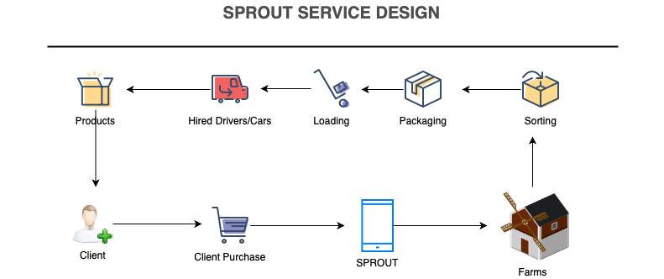
Service Design and Operations Plan
Notes:
Clients go our app to make some purchases
Our customers can also subscribe a specific basket to have it delivered weekly
Once they checked out, the orders go to the farms. They start collecting and packaging the ordered baskets and then wait for our cars come to pick it up and deliver to our customers.

Slide 24
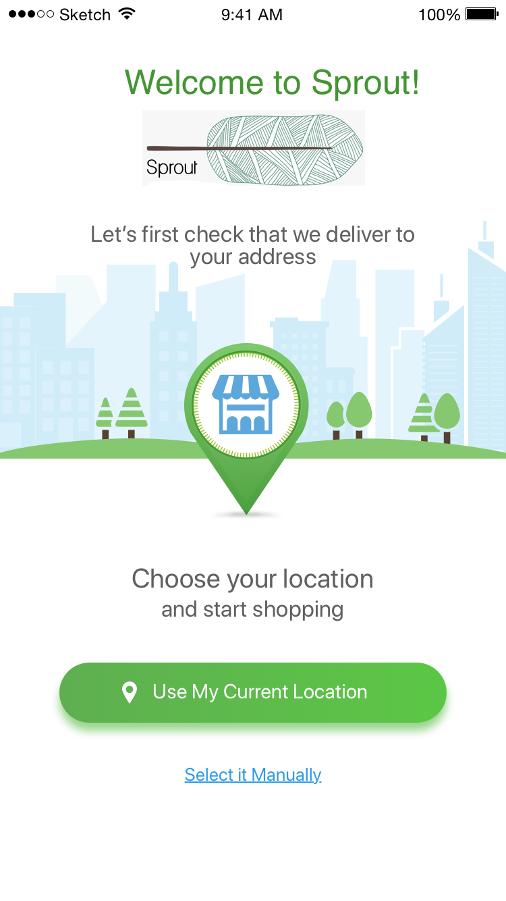
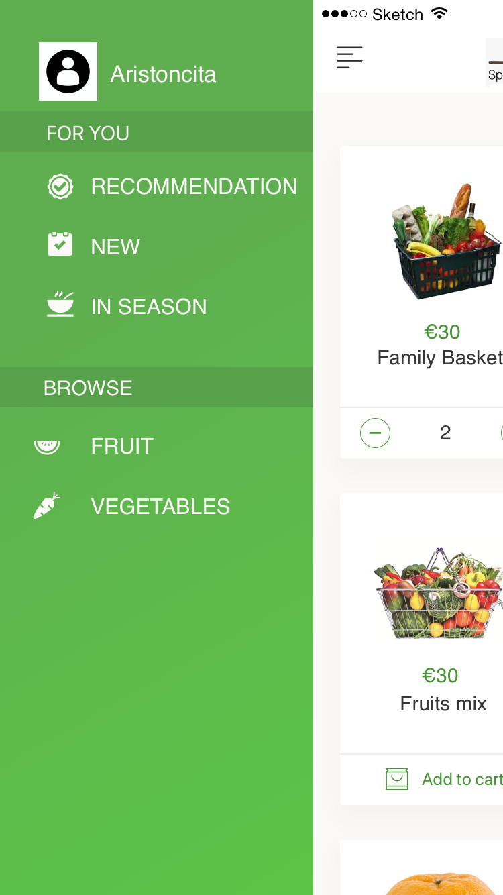
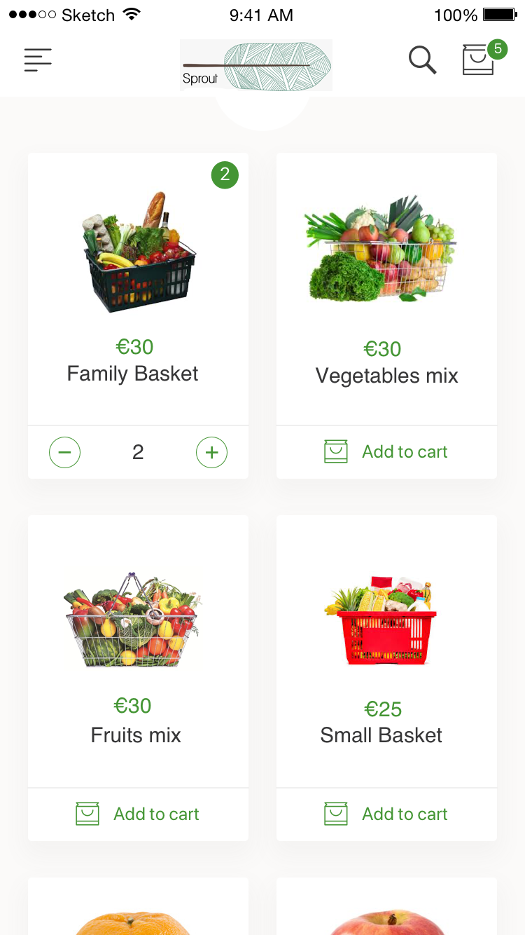
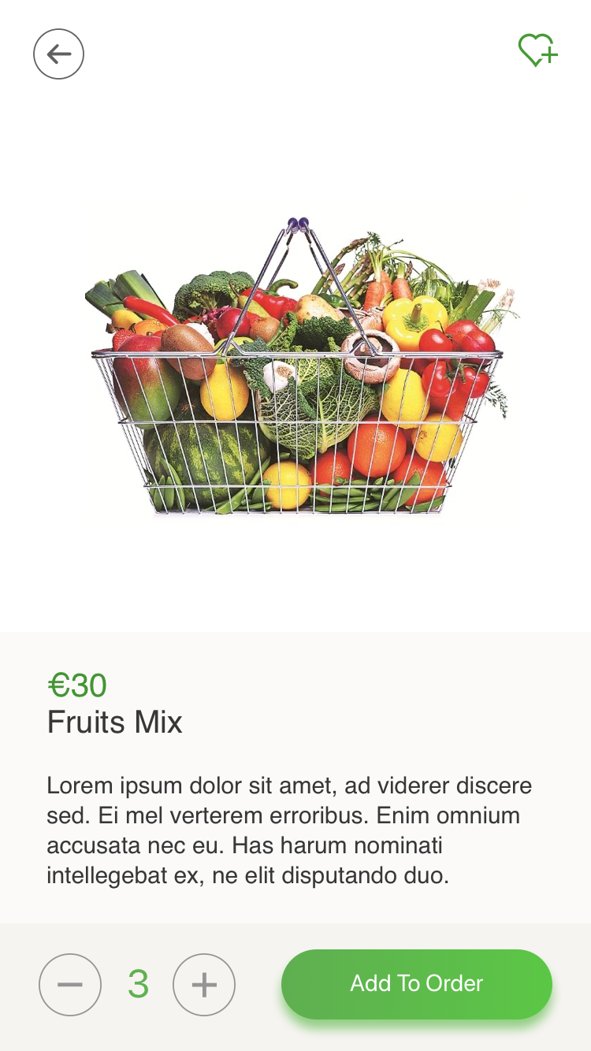
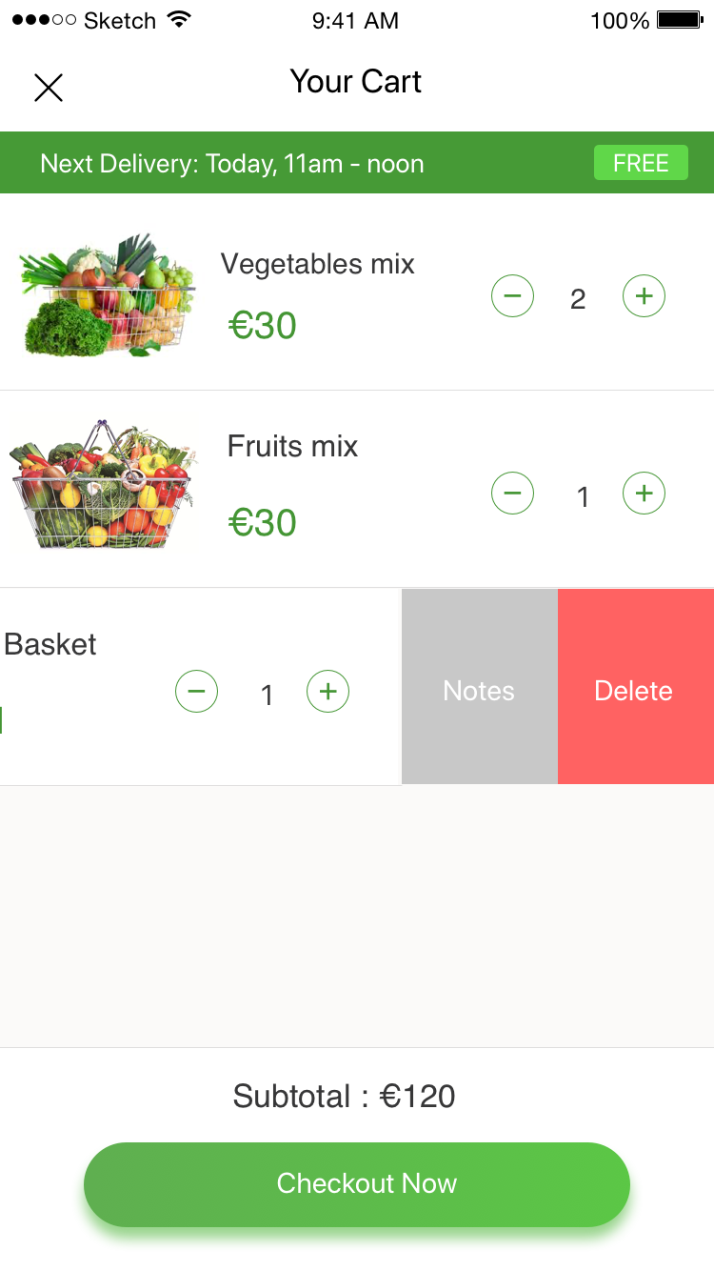
SPROUT Application Prototype
Notes:
Our SPROUT mobile app will be available on IOS and Android platforms. These are some main screens on our app.
Once the users launched the app, they need to choose the location that they want their order to be delivered to
They can navigate between different categories of products. We also have a section for recommended products which I will explain how it works in the next slide
We have many kinds of baskets which have different size, types of products, …
After putting baskets of products to the cart, they can check out to proceed to the delivery phase

Slide 25

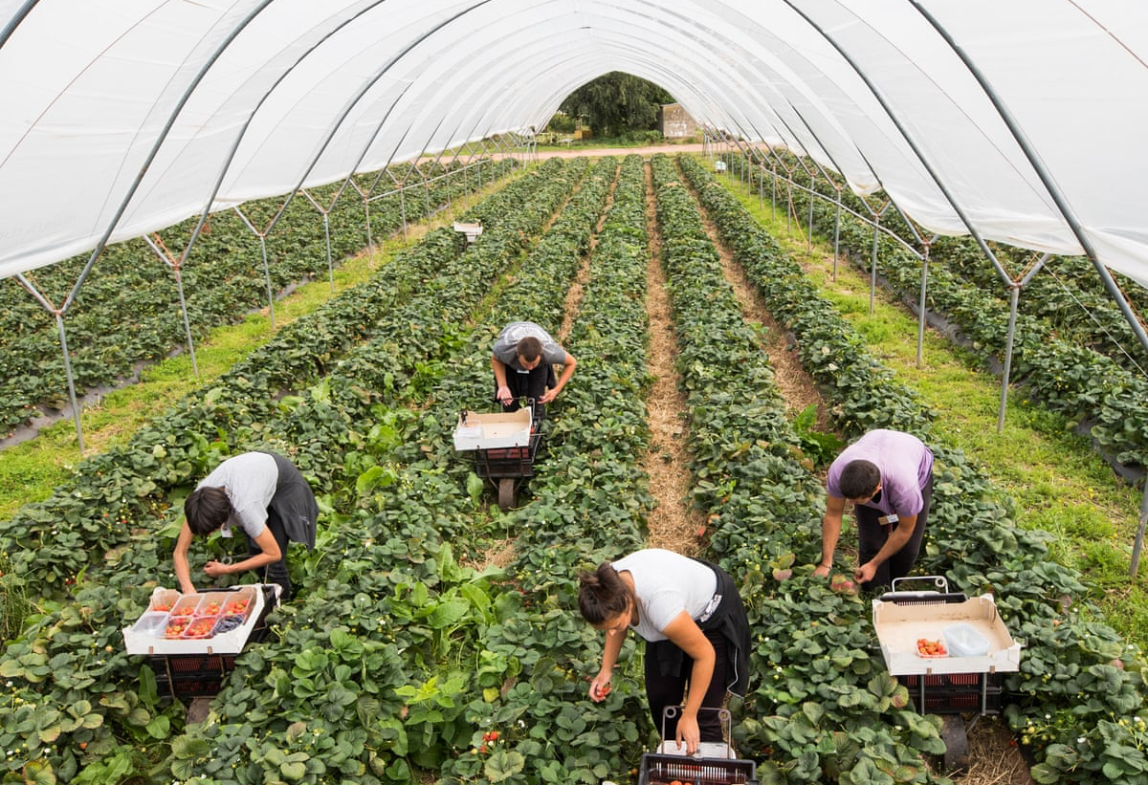
Intelligent Recommendation System
Basket Recommendation
Pricing Recommendation
Growing Recommendation
Notes:
Now I’m gonna introduce you which makes Sprout stands out from our competitors.
We have a Intelligent Recommendation System and both farmers and buyers benefit from our Recommender
First, based on sales data, we will analyze them and make baskets of products which usually go together
Second, we found the data of agricultural products prices from European Union Open Data and based on that, we will give our partner farms some recommendations of the price so they can remain competitive and profitable
Last but not least, our recommender will give suggestions to our partner farms for what to grow based on market needs from our sales data

Slide 26
SPROUT FINANCIAL PLAN

Slide 27
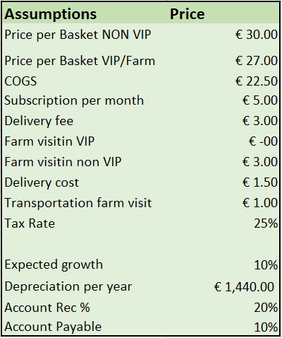
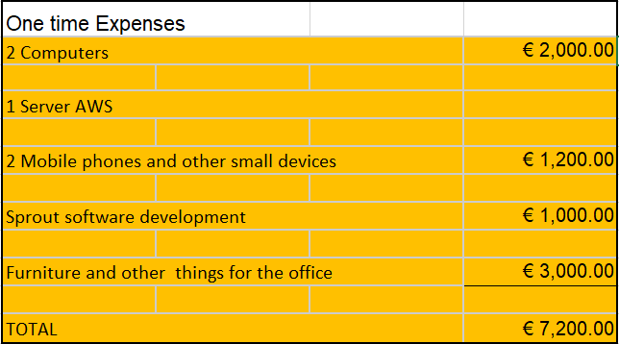
Assumptions and one time expenses

Slide 28
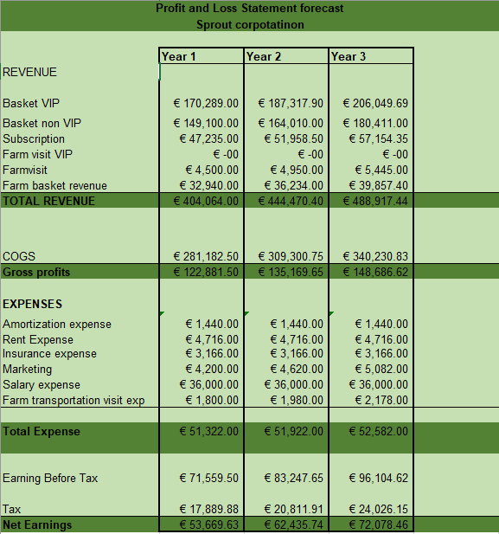
Profit and Loss Statement Forecast

Slide 29
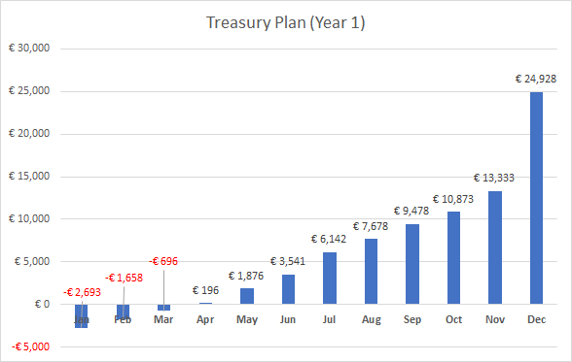

Slide 30
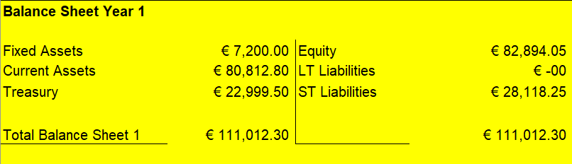
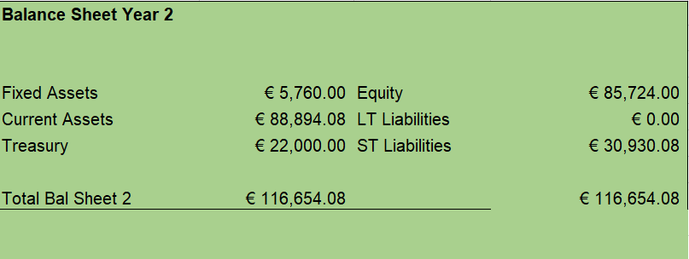
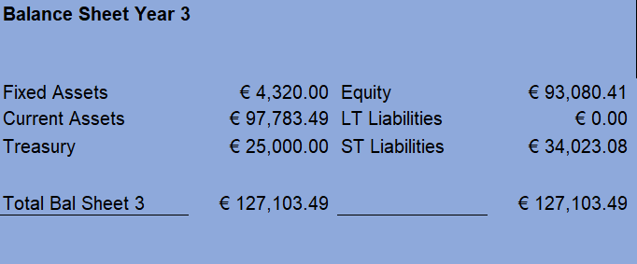

Slide 31
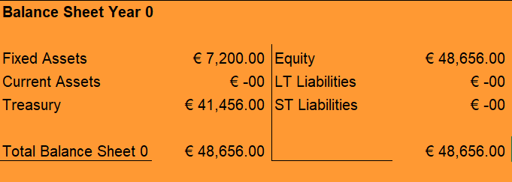

Slide 32
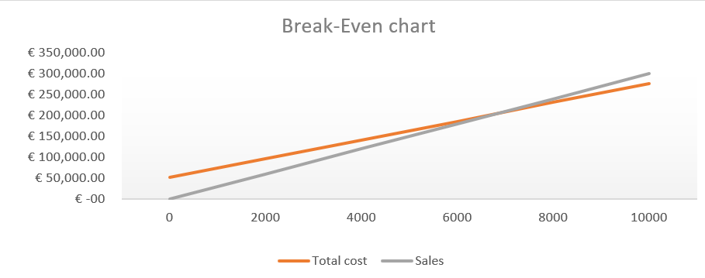
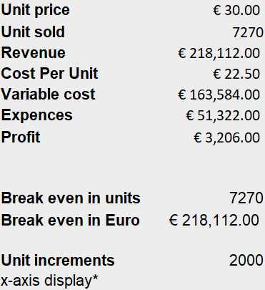
Break-Even Analysis

Slide 33
Cost Control
Strong relationship with the suppliers
Monthly analysis of the performance reports
Yearly contract revision
Discuss and approve changes of growth on a monthly basis
Forecasting
Variable expenses vs. fixed expenses

Slide 34
PROPOSAL FOR INVESTORS

Slide 35
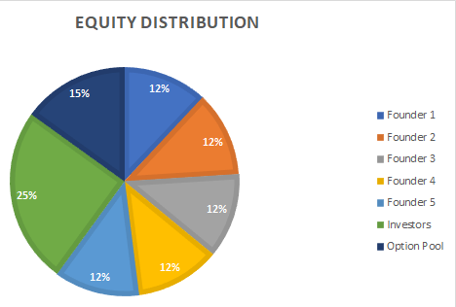
Shareholders
*Option Pool:
Directors, GM, VP, Employees, etc.
Notes:
Engineers: 0.01 - 0.66 %
VP: 1 - 5%
GM: 5 - 10%

Slide 36
Return On Investment (ROI) for Investors
Shareholder | Total Profit (Year 1) | Percentage | Profit
Founders | €50,000.00 | 60% | €30,000.00
Investors |  | 25% | €12,500.00
Option Pool |  | 15% | €7,500.00
ROI on Year 1 = €12,500.00 / €11,156.00 * 100%
112.05%
Notes:
Option Pool: Directors, GM, VP, Employees, etc.
Engineers: 0.01 - 0.66 %
VP: 1 - 5%
GM: 5 - 10%

Slide 37
PROJECT CALENDAR

Slide 38
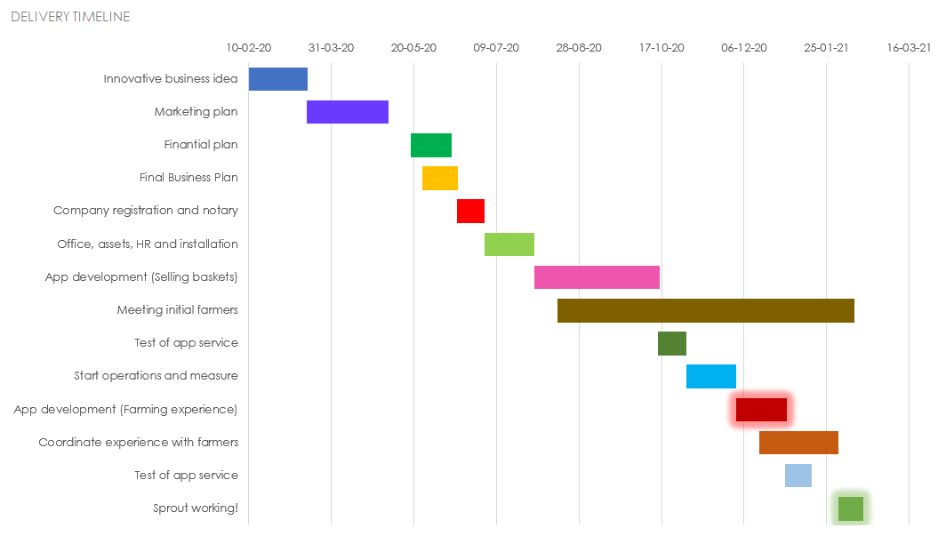
Business Project Beginning Calendar
Main phases
Planification
Installation
Attract farmers
Development Phase 1
Development Phase 2

Slide 39
RISK MANAGEMENT

Slide 40

Risk Management Strategies
Market Scope Strategy
Narrow-scope Strategy
Avoid direct competition with larger companies
Focus on quality
High profit niche
Imitation Strategy
Study practices from successful firms
Put emphasis on distinctive factors
New Business Mindset
Clean slate to implement procedures
Flexibility to adapt to future changes
Notes:
Example 1: Focus on organic products and farming experience
Example 2: Sell baskets, like our competitors. Maintain a commission margin close to competition. EU market prices.
Example 3: Able to accomodate to dynamic, changing environment. Adapt food prices with analytics.

Slide 41
Risk Matrix
Risk | Level
Direct competition with bigger companies | High
Decrease in the size and attractiveness of our market segment | Low
Finding investors interested in the company | High
Hired employees underperform on their tasks | Moderate
Finding farmers willing to partner with the company | High
Customers who sign up in the app are less than expected | Moderate
Promotion strategies do not reach expected number of customers | Low
Notes:
Direct competition: Focus on differentiators, organic products of high quality and farming experience
Decrease in market segment: Reassess products that provide best value through Analytics
FInding investors: Initial investment by founders. Bank loans in Barcelona
Employees underperform: Emphasis on hiring process. Code of ethics.
Finding farmers: Expand working radius, emphasizing benefits.
Less customers in app: Reevaluate benefits of signing up and becoming VIP customer.
Promotion strategies: Marketing strategy. Increase marketing budget.

Slide 42
THANK YOU!

Slide 43
Balance Sheet Year 0
Initial investment:
€7,500.00 for each founder
€11,156.00 from investor(s)

